Slide 1
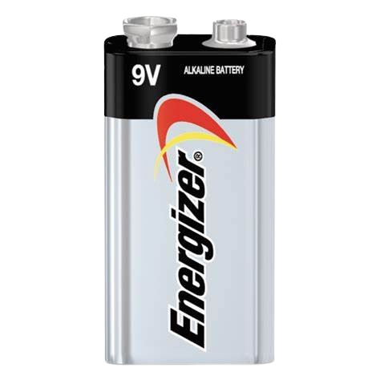
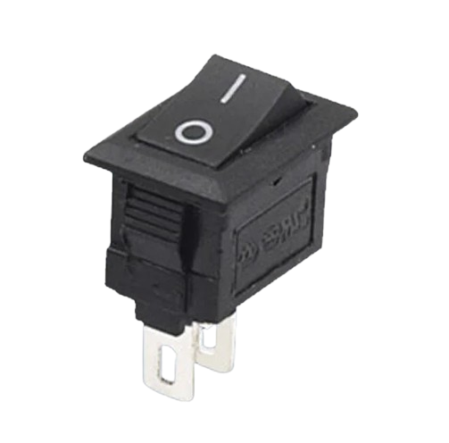
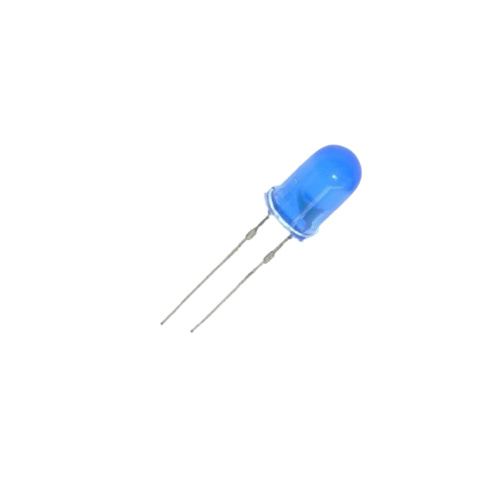
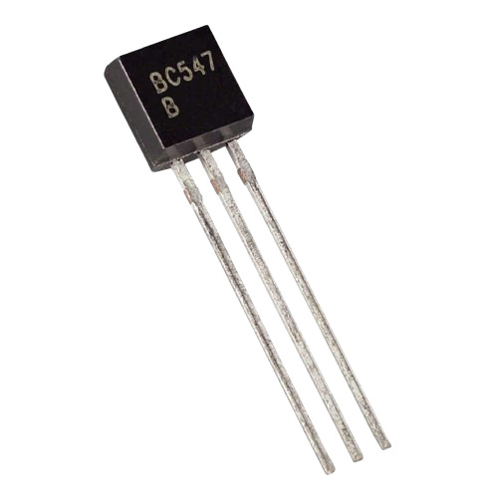
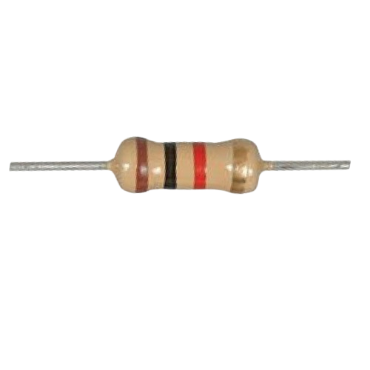
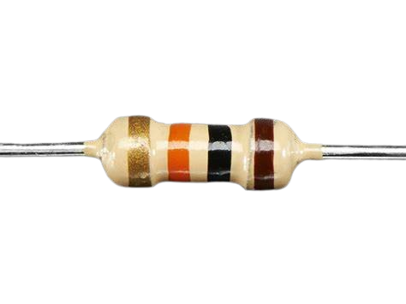
Buda Tech
TTL NOT GATE / INVERTER
1K Resistor
BATTERY
NPN transistor
SWITCH
LED
10K Resistor

Slide 2
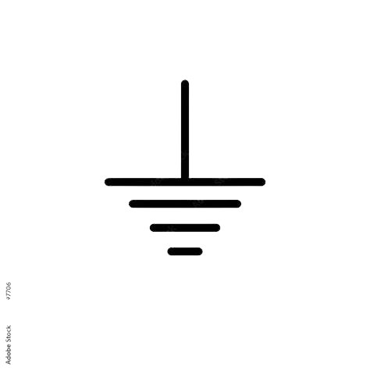
Buda Tech
TTL NOT GATE / INVERTER
1KΏ
E B C
10KΏ
SWITCH | LED
0 | 1
1 | 0

Slide 3
Buda Tech
TTL NOT GATE / INVERTER
1KΏ
OPEN
E B C
VB = 0
IB=0
10KΏ
SWITCH | LED
OFF | ON

Slide 4
Buda Tech
TTL NOT GATE / INVERTER
Transistor
OFF
1KΏ
OPEN
E B C
VB = 0
IB=0
Resistance is High
10KΏ
SWITCH | LED
OFF | ON

Slide 5
Buda Tech
TTL NOT GATE / INVERTER
Transistor
ON
1KΏ
CLOSED
E B C
10KΏ
Resistance is Low
SWITCH | LED
ON | OFF

Slide 6
Buda Tech
TTL NOT GATE / INVERTER
Transistor
ON
1KΏ
CLOSED
E B C
10KΏ
Resistance is Low
SWITCH | LED
ON | OFF

